Slide 1
ns-3 Training

Slide 2
Simulator core
Simulation time
Events
Simulator and Scheduler
Command line arguments
Random variables
Execute a function
(may generate additional events)
Virtual time
Advance the virtual time
to the next event (function)

Slide 3
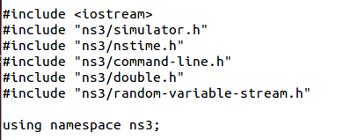
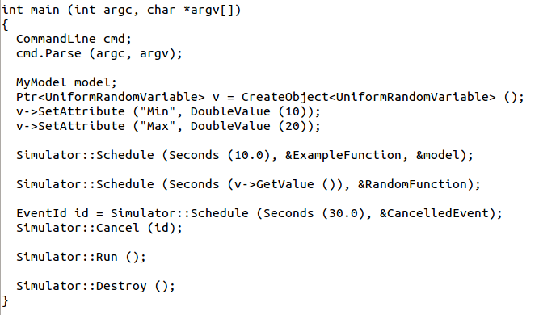
Simulator example

Slide 4

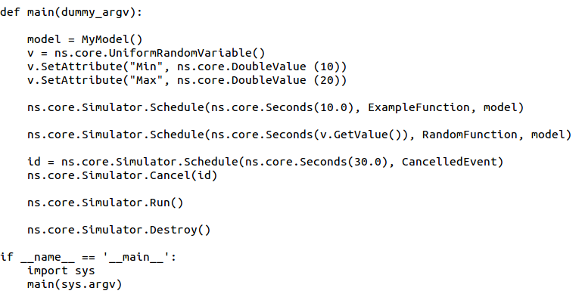
Simulator example (in Python)

Slide 5
Simulation program flow
Handle program inputs
Configure topology
Run simulation
Process outputs

Slide 6

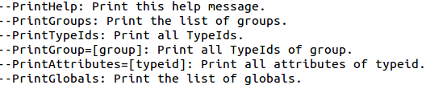
Command-line arguments
Add CommandLine to your program if you want command-line argument parsing
Passing --PrintHelp to programs will display command line options, if CommandLine is enabled
./waf --run "sample-simulator --PrintHelp"

Slide 7
Time in ns-3
Time is stored as a large integer in ns-3
Minimize floating point discrepancies across platforms
Special Time classes are provided to manipulate time (such as standard operators)
Default time resolution is nanoseconds, but can be set to other resolutions
Note: Changing resolution is not well used/tested
Time objects can be set by floating-point values and can export floating-point values
double timeDouble = t.GetSeconds();
Best practice is to avoid floating point conversions where possible

Slide 8
Events in ns-3
Events are just function calls that execute at a simulated time
i.e. callbacks
this is another difference compared to other simulators, which often use special "event handlers" in each model
Events have IDs to allow them to be cancelled or to test their status

Slide 9
Simulator and Schedulers
The Simulator class holds a scheduler, and provides the API to schedule events, start, stop, and cleanup memory
Several scheduler data structures (calendar, heap, list, map) are possible
"RealTime" simulation implementation aligns the simulation time to wall-clock time
two policies (hard and soft limit) available when the simulation and real time diverge

Slide 10
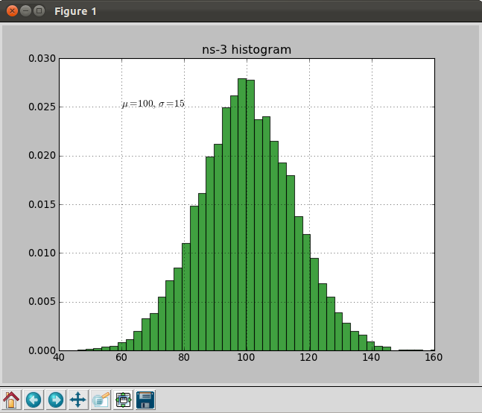
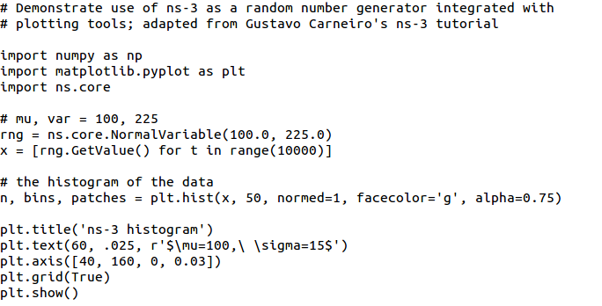
Random Variables
from src/core/examples/sample-rng-plot.py
Currently implemented distributions
Uniform: values uniformly distributed in an interval
Constant: value is always the same (not really random)
Sequential: return a sequential list of predefined values
Exponential: exponential distribution (poisson process)
Normal (gaussian), Log-Normal, Pareto, Weibull, triangular

Slide 11
Random variables and independent replications
Many simulation uses involve running a number of independent replications of the same scenario
In ns-3, this is typically performed by incrementing the simulation run number
not by changing seeds

Slide 12
ns-3 random number generator
Uses the MRG32k3a generator from Pierre L'Ecuyer
http://www.iro.umontreal.ca/~lecuyer/myftp/papers/streams00.pdf
Period of PRNG is 3.1x10^57
Partitions a pseudo-random number generator into uncorrelated streams and substreams
Each RandomVariableStream gets its own stream
This stream partitioned into substreams

Slide 13
Key Terminology
Seed: A set of values that generates an entirely new PRNG sequence
Stream: The PRNG sequence is divided into non-overlapping intervals called streams
Run Number (substream): Each stream is further divided to substreams, indexed by a variable called the run number.

Slide 14
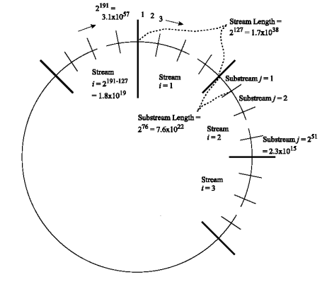
Streams and Substreams
Incrementing the
Run Number will move
all streams to a new
substream
Each ns-3
RandomVariableStream
object is assigned to a
stream (by default,
randomly)
Figure source: Pierre L’Ecuyer, Richard Simard, E. Jack Chen, and W. David Kelton.
An object-oriented random number package with many long streams and substreams. Operations Research, 2001.

Slide 15
Run number vs. seed
If you increment the seed of the PRNG, the streams of random variable objects across different runs are not guaranteed to be uncorrelated
If you fix the seed, but increment the run number, you will get uncorrelated streams

Slide 16

Setting the stream number
The ns-3 implementation provides access to 2^64 streams
2^63 are placed in a pool for automatic assignment, and 2^63 are reserved for fixed assignment
Users may optionally assign a stream number index to a random variable using the SetStream () method.
This allows better control over selected random variables
Many helpers have AssignStreams () methods to do this across many such random variables

Slide 17
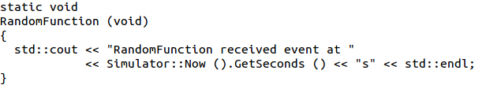
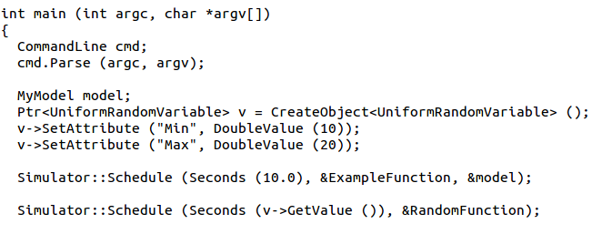
Putting it together
Example of scheduled event
Demo real-time, command-line, random variables...

